Slide 1



Get Bulls
Not Bears
Stock Analysis App
Notes:
“Hello I am Gaurav Nemani and I Welcome you to the presentation of 'Get Bulls Not Bears'—a stock analysis app designed to provide comprehensive insights into stock performance. I'm excited to guide you through the app’s features, its architecture, and how it can empower investors and analysts alike."

Slide 2

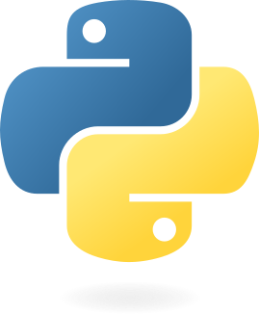


APP ARCHITECTURE
The app was made using Python and Streamlit
Libraries used: NumPy, Pandas, Matplotlib, Plotly, Streamlit, YFinance and StockNews
Notes:
"This app was developed using Python, with Streamlit as the backbone for creating an interactive and user-friendly interface. The core libraries powering this app include NumPy, Pandas, Matplotlib, and Plotly for data handling and visualization. Additionally, YFinance and StockNews APIs bring in real-time stock data and news analysis. Together, these tools make the app both functional and efficient."

Slide 3

APP FEATURES
Company
Key
Statistics
Company
Fundamentals
Prediction
Simulation
Charts
Top
News
News
Sentiment
Scores
Portfolio
Analysis
Notes:
"The app offers a range of features. Users can access key company statistics, top news stories, and sentiment scores. It provides interactive charts, company fundamentals, portfolio analysis tools, and even a prediction simulation using Monte Carlo methods. These elements combine to deliver a complete toolkit for stock analysis."

Slide 4

SUMMARY PAGE
01
02
03
Robust & easy UI with menu buttons for quick navigation and ticker update option on the collapsable sidebar
Ticker with all Stocks from the S&P500 with timeframe and download access to the entire data
Company Information, Key Statistics, Top 5 Share Holders, Area Plot of Stock along with Volume plot.
Notes:
"The summary page is the hub of the app. It features a ticker with stocks from the S&P 500, allowing users to select a timeframe and download historical data. Users can view company information, key statistics, top shareholders, and interactive plots showcasing stock performance and volume. The clean and intuitive UI includes a collapsible sidebar for seamless navigation and quick updates."

Slide 5
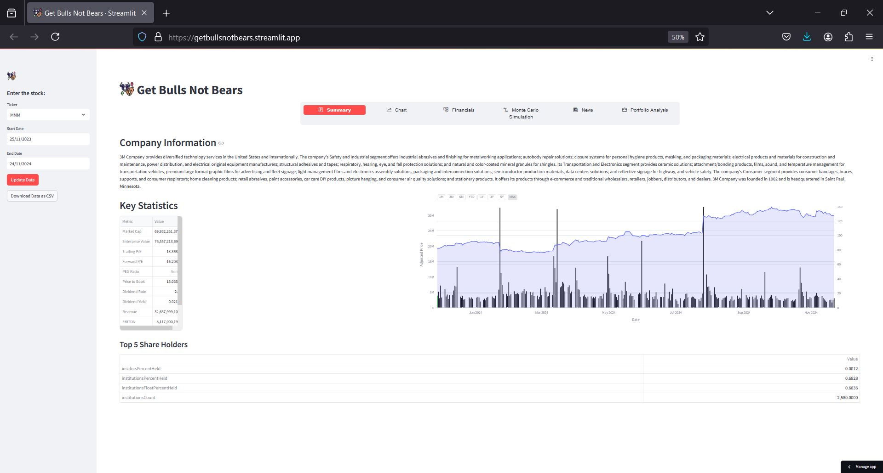

Slide 6
CHART
PAGE
Line Chart
A line chart showing the Adjusted Price with interval options of 1M, 3M, 6M, YTD, 1Y, 3Y, 5Y and Max range.
Candlestick Chart
A Candlestick chart showing the Adjusted Price with interval options of 1M, 3M, 6M, YTD, 1Y, 3Y, 5Y and Max range.
1M: 1 Month, 3M: 3 Months, 6M: 6 Months, YTD: Year Till Date, 1Y: 1 Year, 3Y: 3 Years, 5Y: 5 Years, Max: Entire Range of the Stock
Notes:
"The chart page offers two visualization types: line charts and candlestick charts. Users can explore the adjusted stock prices across intervals like 1 month, 3 months, 6 months, YTD, and longer horizons up to the maximum available range. These charts provide a clear and dynamic way to track stock trends over time."

Slide 7
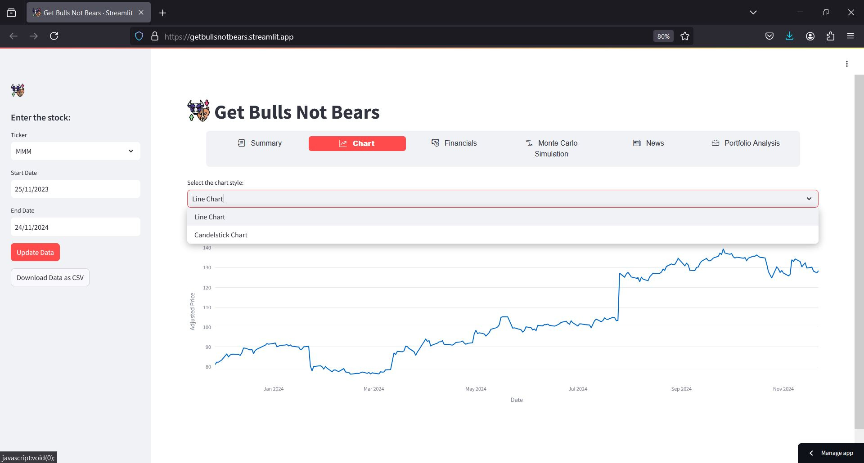

Slide 8

FINANCIALS PAGE
BALANCE
SHEET
CASH FLOW
STATEMENT
INCOME
STATEMENT
Company Balance Sheet of selected stock ticker: Drop down selection for Annual and quarterly data
Cash-flow Statement of selected stock ticker: Drop down selection for Annual and quarterly data
Income Statement of selected stock ticker: Drop down selection for Annual and quarterly data
Notes:
"On the financials page, users can dive into detailed company financials, including balance sheets, cash flow statements, and income statements. A dropdown menu allows selection between annual and quarterly data, giving users the flexibility to tailor the view to their analysis needs."

Slide 9
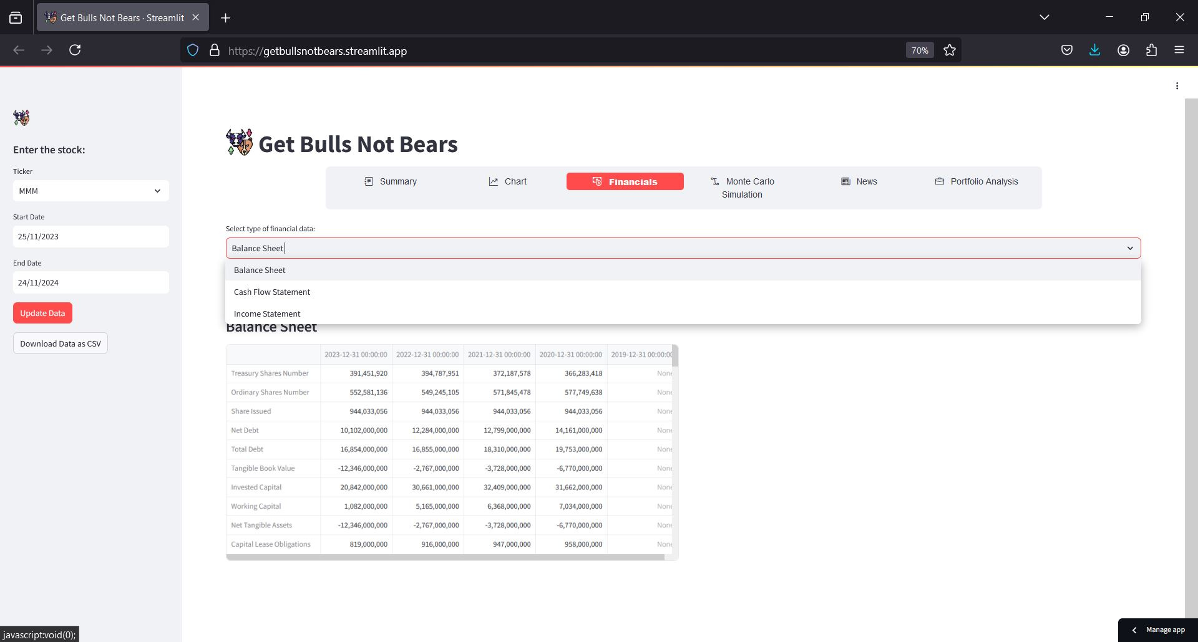

Slide 10
MONTE CARLO
SIMULATION
Predictive Analysis of Future Stock Price
Using Monte Carlo Simulation, we can analyse the simulated price of the stock selected after 200 days, time horizon of 30, 60 and 90 days can be selected as well as number of simulations can be selected from 200, 500 and 1000 times.
Notes:
"One of the standout features is the Monte Carlo Simulation for predictive analysis. Users can simulate future stock prices over a time horizon of 30, 60, or 90 days. They can also customize the number of simulations, ranging from 200 to 1,000. This tool provides a data-driven way to anticipate stock performance."

Slide 11
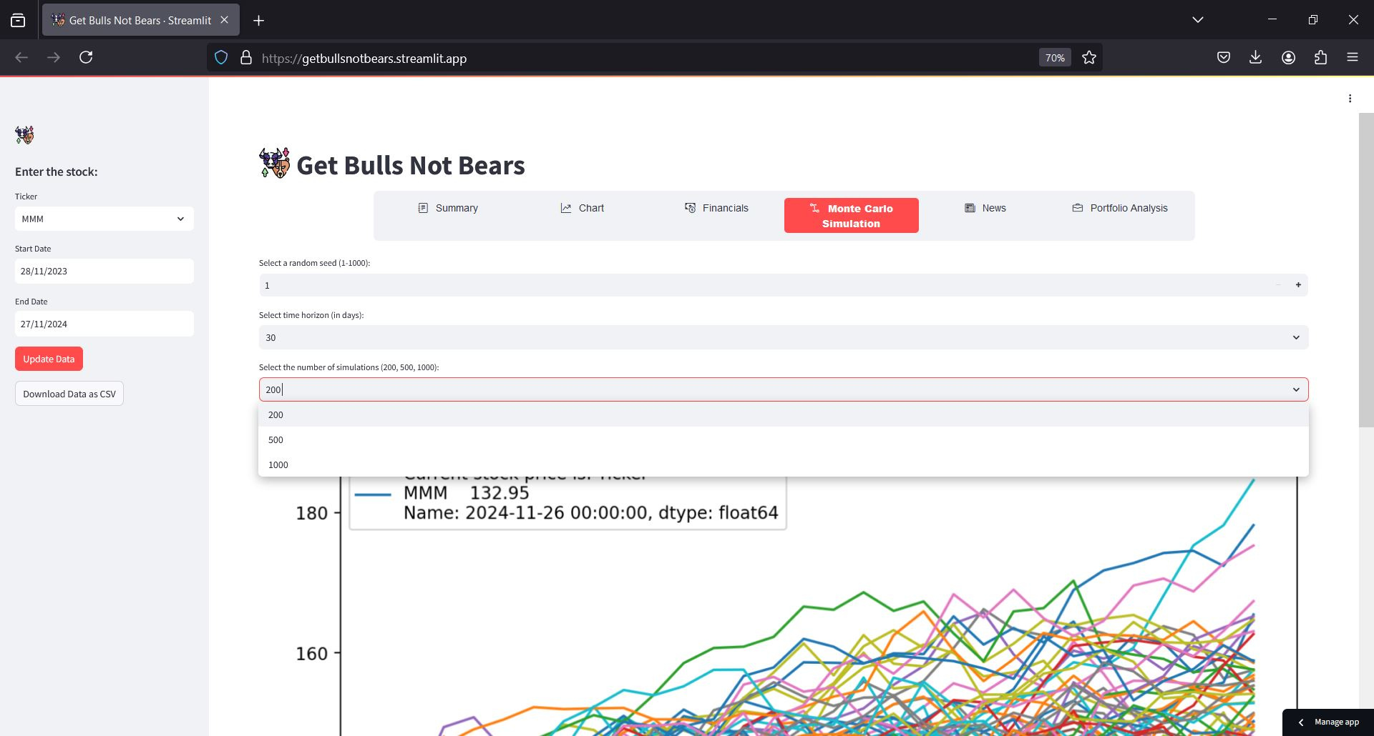

Slide 12

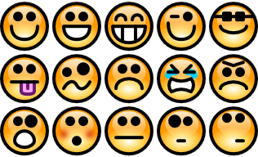
NEWS & SENTIMENT PAGE
Top 20 News
Sentiment Score
Varied Sources
Title & Content
Notes:
"This page aggregates the top 20 news articles from various sources, providing a sentiment score for each. Titles and content summaries help users quickly assess the market sentiment surrounding a particular stock or industry."

Slide 13
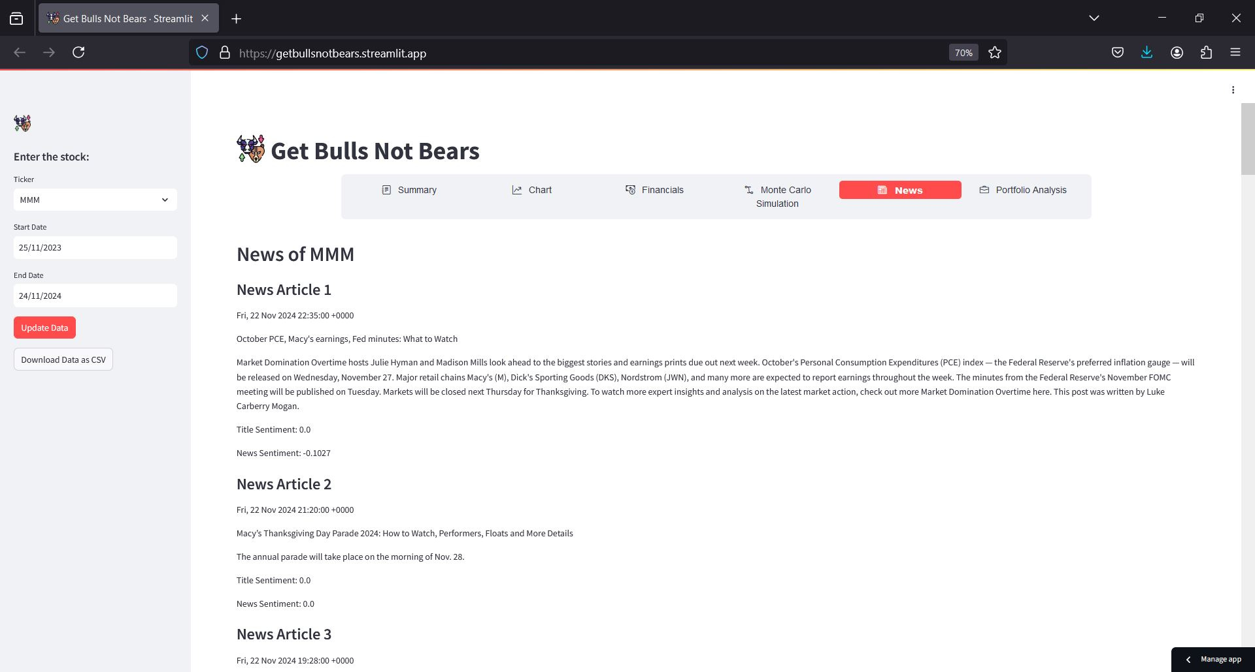

Slide 14
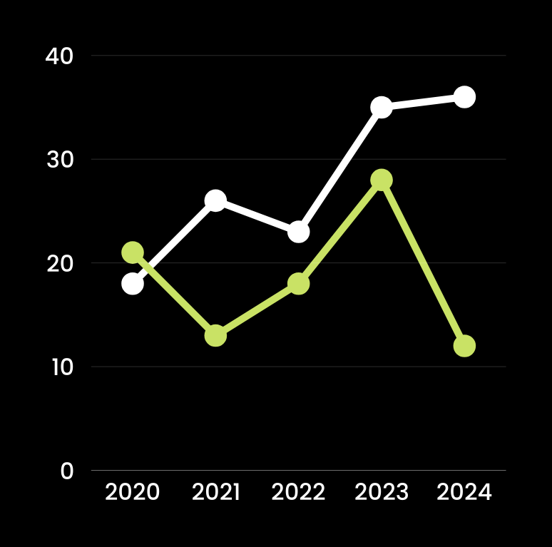
Portfolio
Analysis
Select multiple stocks to compare and compare it to the S&P500 to see if ones portfolio of stocks is doing better or worse than the S&P500.
"Be fearful when others are greedy and greedy only when others are fearful." — Warren Buffett
Notes:
"With the portfolio analysis feature, users can compare their portfolio's performance against the S&P 500. This helps investors understand whether their selected stocks are outperforming or underperforming the broader market. As Warren Buffett says, 'Be fearful when others are greedy, and greedy when others are fearful.' This tool helps quantify that perspective."

Slide 15
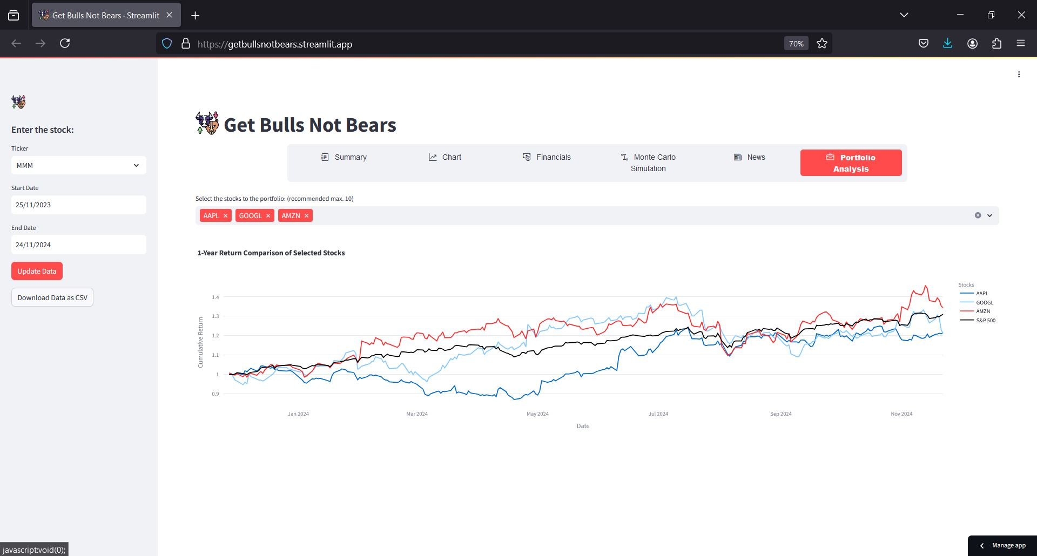

Slide 16
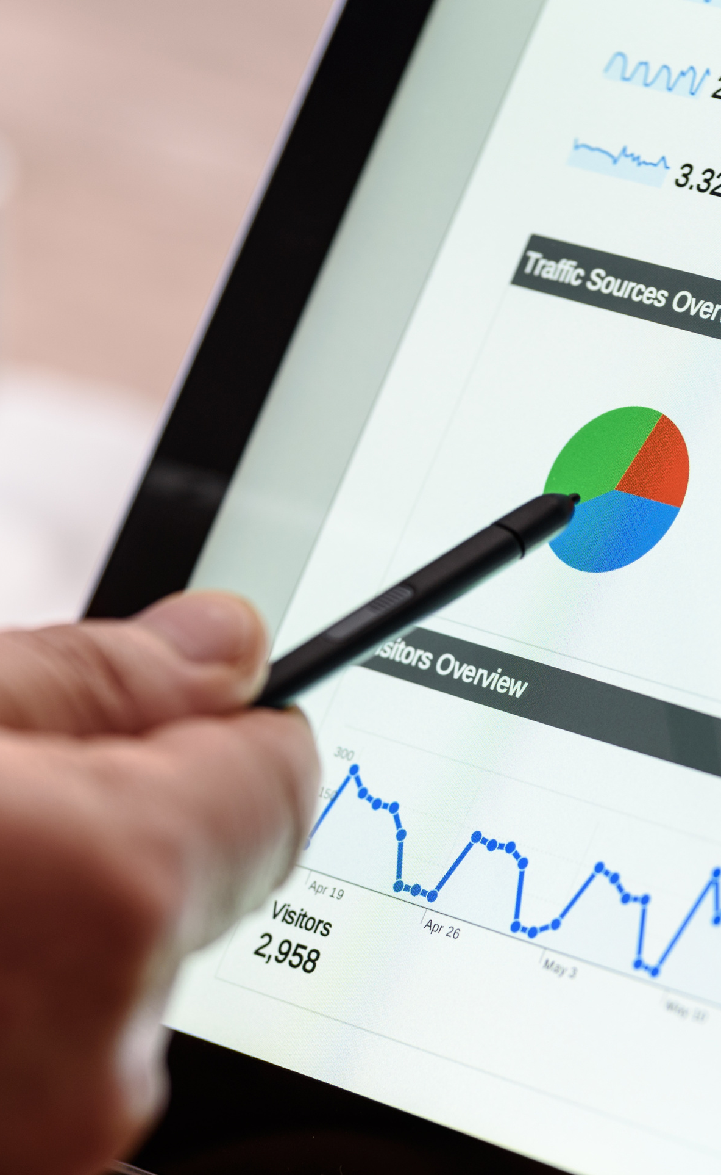
INDIVIDUAL
INVESTORS
TARGET
USERS
ANALYSTS
PORTFOLIO
MANAGERS
Notes:
"This app is designed for individual investors, analysts, and portfolio managers. Whether you're making personal investment decisions or managing a client portfolio, 'Get Bulls Not Bears' provides actionable insights for every level of expertise."

Slide 17
Thank You
Gaurav Nemani
Notes:
“Thank you for your time and attention. I hope this walkthrough of 'Get Bulls Not Bears' highlighted the app's capabilities and potential to enhance your stock analysis. Happy investing!“

